Slide 1
Design and Implementation of Semantic Communication
ST. VINCENT PALLOTTI
COLLEGE OF ENGINEERING & TECHNOLOGY, NAGPUR
(Department of Electronics & Telecommunication Engineering)
Academic Year: 2025–2026, Semester: VI
Project Guide :
Prof. Dr. Madhura Kulkarni (SVPCET)
Industry Guide:
Prof. Dr. Prabhat Sharma
(VNIT)
Presented by:
Sonal Surkar (23003061)
Anshu Sukare (23003062)
Abhishek Borkar(23003063)
Tushar Mankar (21003051)

Slide 2
Introduction
What is Communication System ?
A system used to transfer information from one place to another.
It consists of a transmitter, channel, and receiver.
It enables communication of data, voice, and video signals.
Block diagram :
Click here to run simulation

Slide 3
What is Semantic Communication ?
Semantic communication is a modern type of communication system that focuses on transmitting the meaning (semantics) of a message rather than the exact data or bits, making communication more efficient and intelligent.
Example
Traditional: “The temperature is 40°C”
Semantic: “It is very hot today”
(Both convey the same meaning, even though the words/data are different.)
In traditional communication systems, the goal is to send data accurately (bit-by-bit). But in semantic communication, the goal is to ensure the receiver understands the intended meaning, even if some data is lost or changed.

Slide 4
Steps of Semantic Communications
1. Message Creation
2. Semantic Representation/Compression(Semantic Encoding)
4. Transmission
5. Semantic Decoding
6. Knowledge Integration
7. Message Reconstruction (Final Output)
Types of Data Transfer –
1. Text Data - Consists of characters, words, and numbers.
2. Audio (Voice) Data - Contains sound or speech signals.
3. Video Data - Combination of moving images + sound.
4. Image (Graphics) Data - Includes photos, diagrams, pictures.

Slide 5
Objectives of Semantic Communication
It allows transmission of text, image and video data by reducing data rate.
It improves throughput.
It increases communication speed and efficiency.
Block diagram : Click here to run simulation

Slide 6
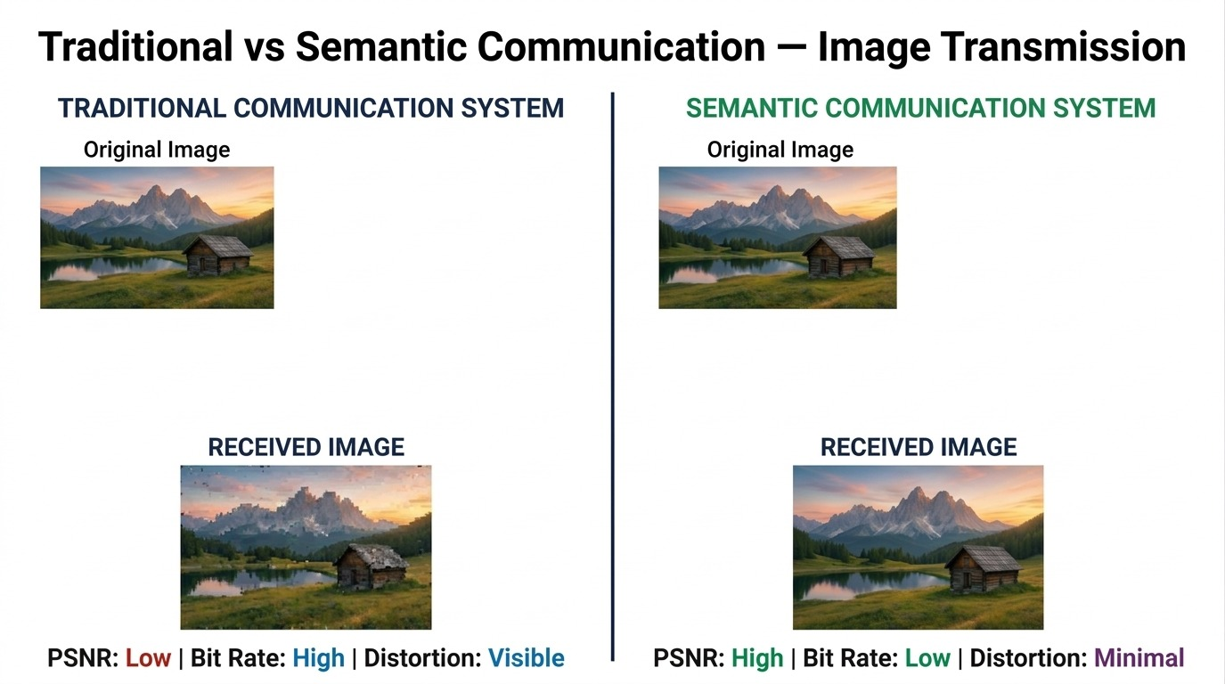

Slide 7
Literature Review
Paper Name | Method Used | Working Principle | Advantages | Limitations
Physical Layer Security Analysis (2025) | Physical Layer Security + Semantic DL | Uses channel randomness + semantic encoding | Low latency, improved security | Trade-off with accuracy, channel dependent
DeepSC | Deep Learning | Encodes meaning using neural networks | Works in low SNR, efficient | Black-box, model theft risk
Resource Allocation for Semantic Comm | Optimization-based | Allocates bandwidth using semantic importance | Efficient resource use | Complex, needs channel info
Semi-NOMA Semantic Communication | Hybrid Semantic + Bit Communication | Combines semantic & traditional signals | Flexible and scalable | Interference complexity
Semantic Communication on Digital Wireless Communication Systems | Semantic Encoding + Digital Wireless Integration | Maps semantic features into digital wireless signals | Improves efficiency over traditional comm | Depends on model accuracy, channel sensitivity
A Survey on Semantic Communications in Internet of Vehicles | Survey (Various ML/DL Methods) | Reviews semantic methods in IoV scenarios | Comprehensive overview, identifies challenges | No implementation, only analysis
An Autoencoder-Based Task-Oriented Semantic Communication System for M2M Communication | Autoencoder-based Deep Learning | End-to-end learning for task-oriented communication | High efficiency, task-specific optimization | Requires training data, generalization issues

Slide 8
Problem Definition
Need of Semantic Communication -
Motivation for Semantic Communication
Efficient Data Transmission
Better Understanding
Reduced Network Load
Improves Reliability
Useful for AI Applications
Low Latency Communication
Throughput Improvement
Reduced Data Rate Requirement
Higher Efficiency
Low Latency (Faster Communication)
Better Quality of Service (QoS)

Slide 9
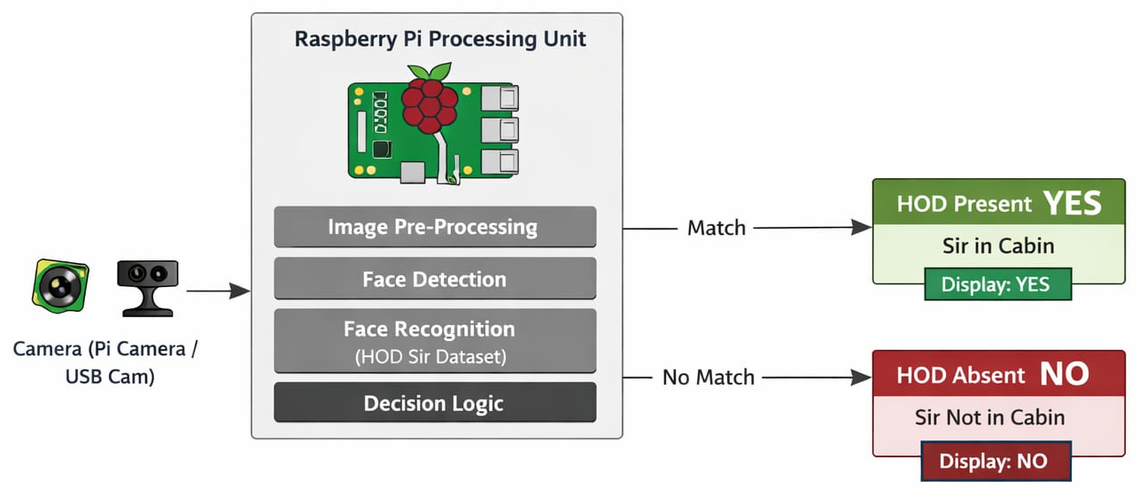
Proposed System / Methodology
Current Problem Statement :
Face recognition system to detect whether HOD sir is in cabin or not
This system uses AI-based face recognition to automate cabin monitoring.
Block Diagram :

Slide 10
References
Sci Space website
Semantic Information Theory and Applications- Meixia Tao, Kai Niu, Youlong Wu (2023)
Feature-Driven Semantic Communication for Efficient Image Transmission- Ji Zhang, Ying Zhang, Baofeng Ji, Anmin Chen, Aoxue Liu, Hengzhou Xu (2023)
An Autoencoder-Based Task-Oriented Semantic Communication System for M2M Communication- Hao Xie, Zhijin Qin, Geoffrey Ye Li (2024)

Slide 11


